Slide 1
Web scraping to gain company insights
Scrape and analyse customer review data to uncover findings for British Airways

Slide 2
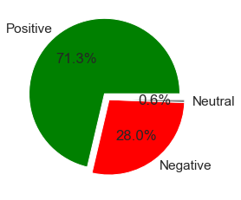
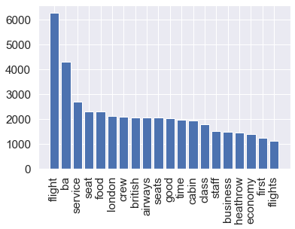
Result
Out of 3538 reviews, 2524 were positive, 992 were negative and 22 neural, that means customers have quite good reviews about their flights
The frequency chart show that the key topics within the reviews include “service”, “seat”, ”food”, ”crew”… showing that people are actively talking about their experience

